Slide 1

SHOPCART
A data driven Ecommerce Platform

Slide 2
TABLE OF CONTENTS
01
02
03
04
05
06
ABOUT
OBJECTIVES
TECH STACKS
FEATURES
UI
CONCLUSION

Slide 3
ABOUT THE PROJECT
ShopCart is a cutting-edge E-commerce platform designed to revolutionize online retail.
It redefines the shopping experience, offering a seamless, user-friendly interface.

Slide 4
OBJECTIVES
To provide an exceptional E-commerce experience for shoppers while equipping platform owners and managers with critical data-driven insights.

Slide 5
TECH STACKS USED
HTML
CSS
ReactJS
Material UI
Recharts

Slide 6
FEATURES
Dynamic Product Listing
Product Insights
Our Dynamic Product Listing feature ensures a dynamic and engaging shopping experience, allowing users to explore a constantly evolving product catalog, making the platform a dynamic marketplace for both customers and vendors.
With Product Insights, ShopCart lets you stay ahead by monitoring product popularity and demand, ensuring you can align your inventory with customer preferences for maximum sales impact.
Sales Analytics
User Management
ShopCart's Sales Analytics provides a comprehensive view of sales trends and performance, enabling data-driven decisions that optimize revenue and market strategies.
ShopCart simplifies user account management with its Admin Panel, offering intuitive tools for administrators to manage accounts, ensuring a smooth and secure user experience.

Slide 7
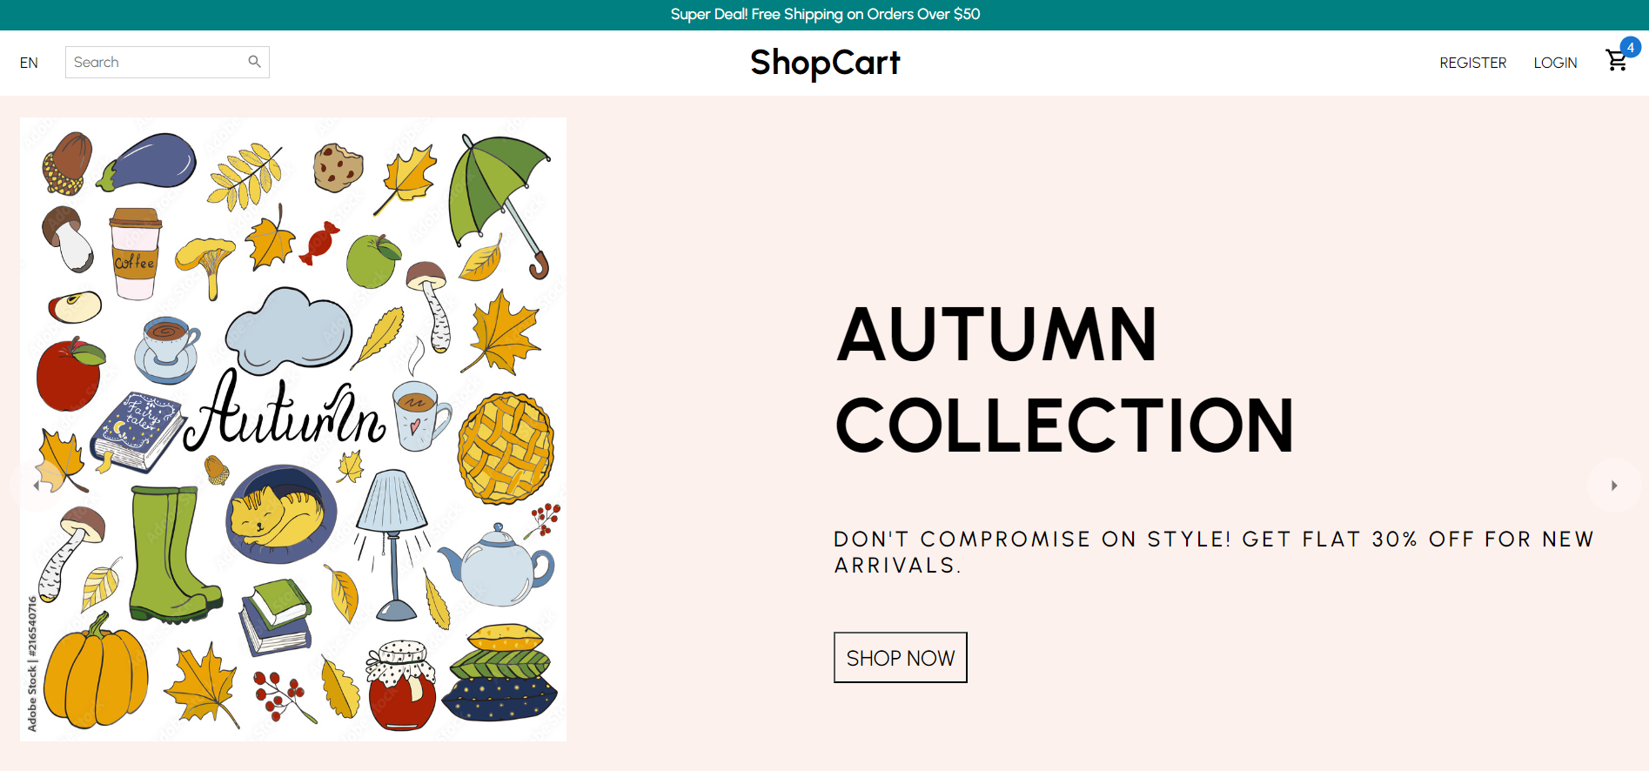
Home Page

Slide 8
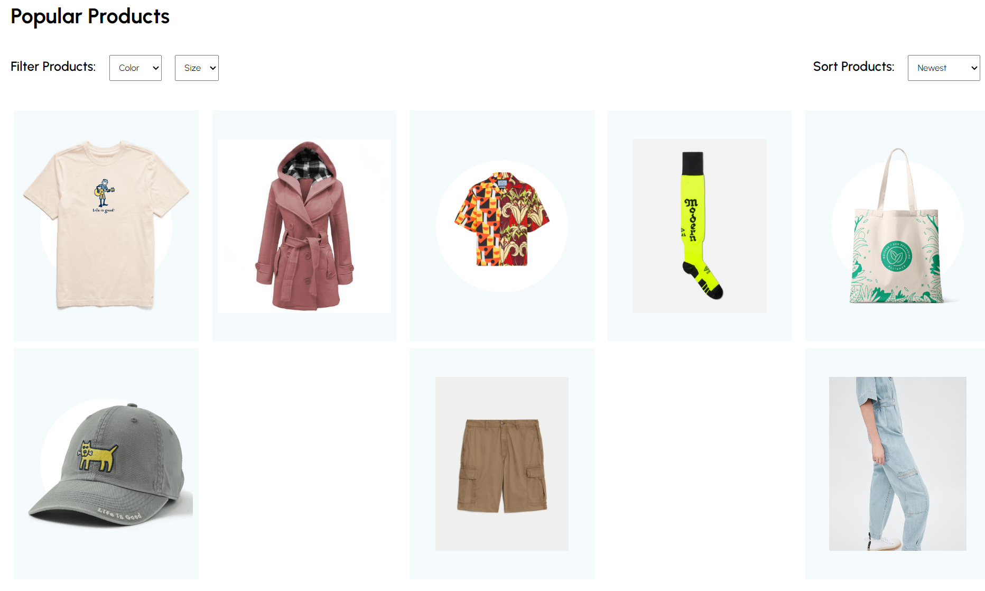
Listed Products Page

Slide 9
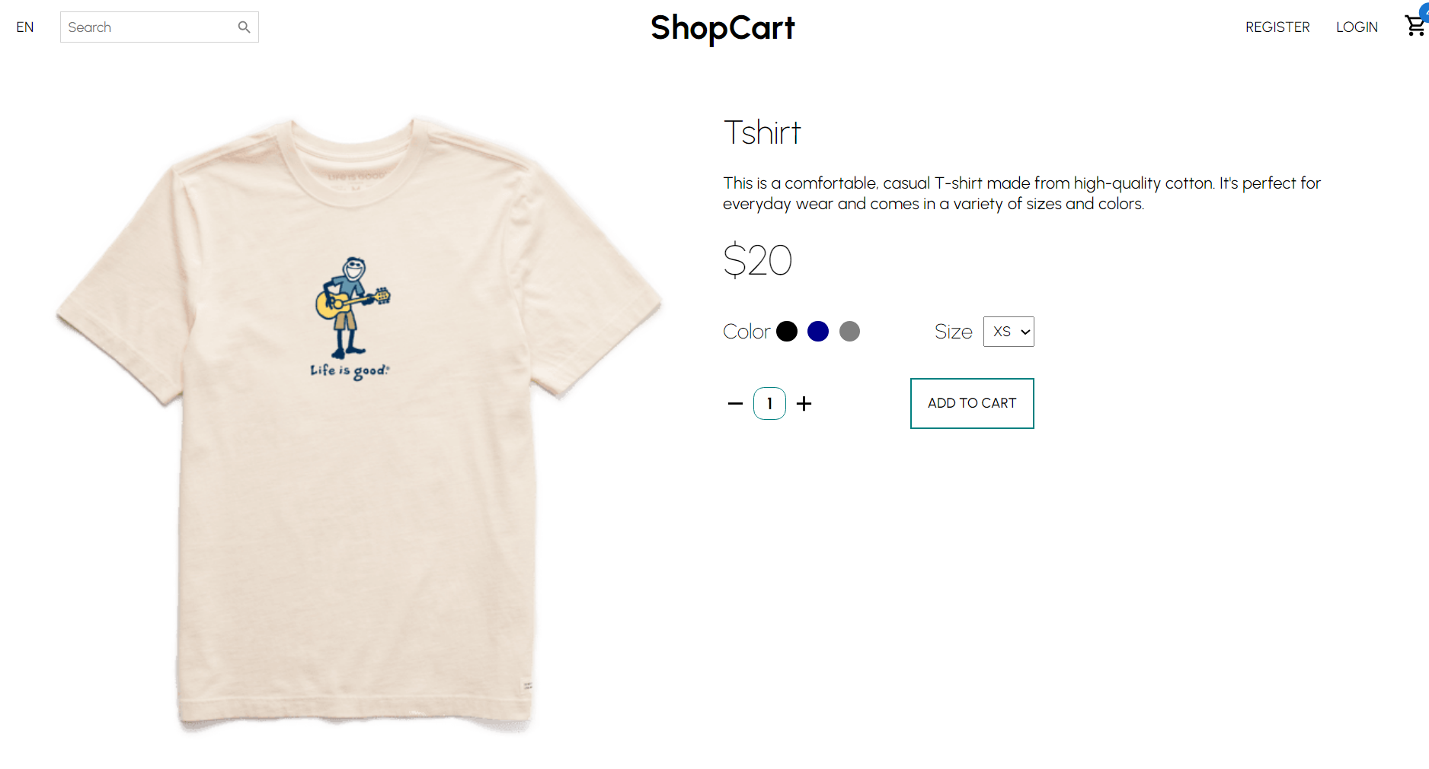
Product Page

Slide 10
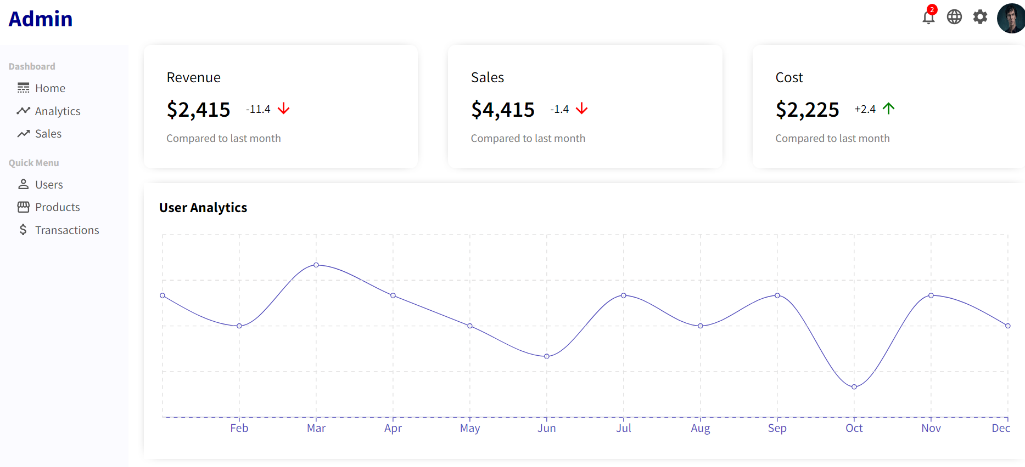
Sales Analytics Page

Slide 11
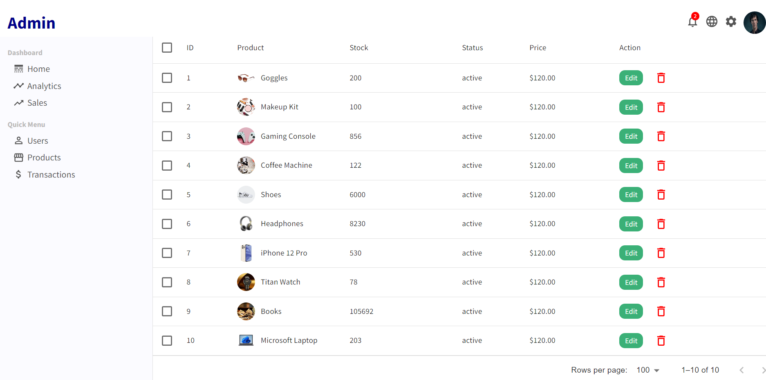
Product Listing Page

Slide 12

THANKS!
Harsh Shah (21BCP359)
Karan Shah (21BCP377)

